Slide 1


</>
EASTERN CINEPLEX
-CUI based C-project
A C-project submission for First Semester/First Year
Bachelor ‘s in Electronics, Communication and Information Engineering

Slide 2
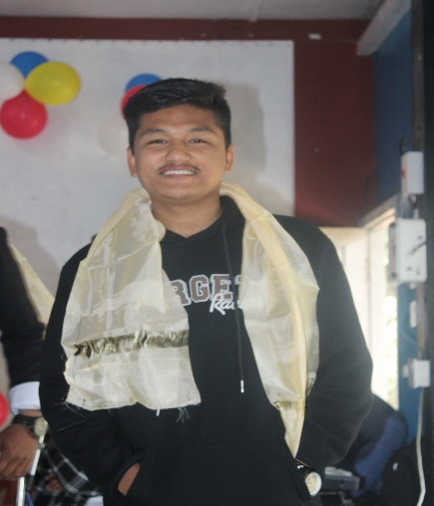
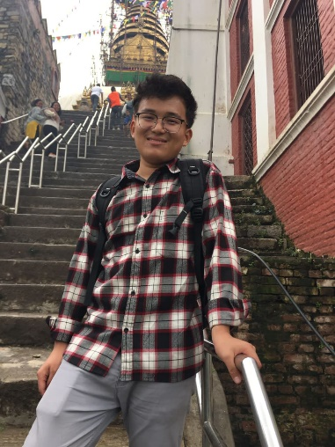
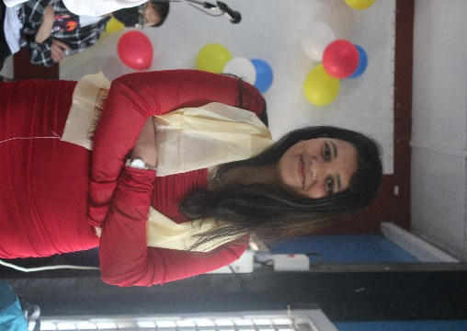
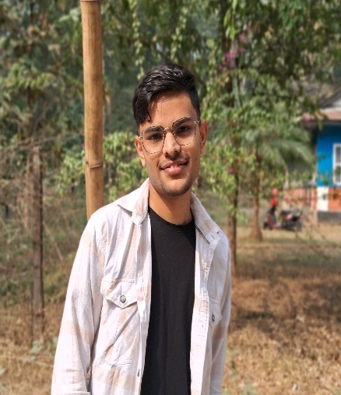
OUR TEAM MEMBERS
Prashan Chenta Rai
Dhiraj Bikram Rai
Sneha Karna
080BEI030
080BEI017
080BEI042
Abhishek Niraula
080BEI004

Slide 3
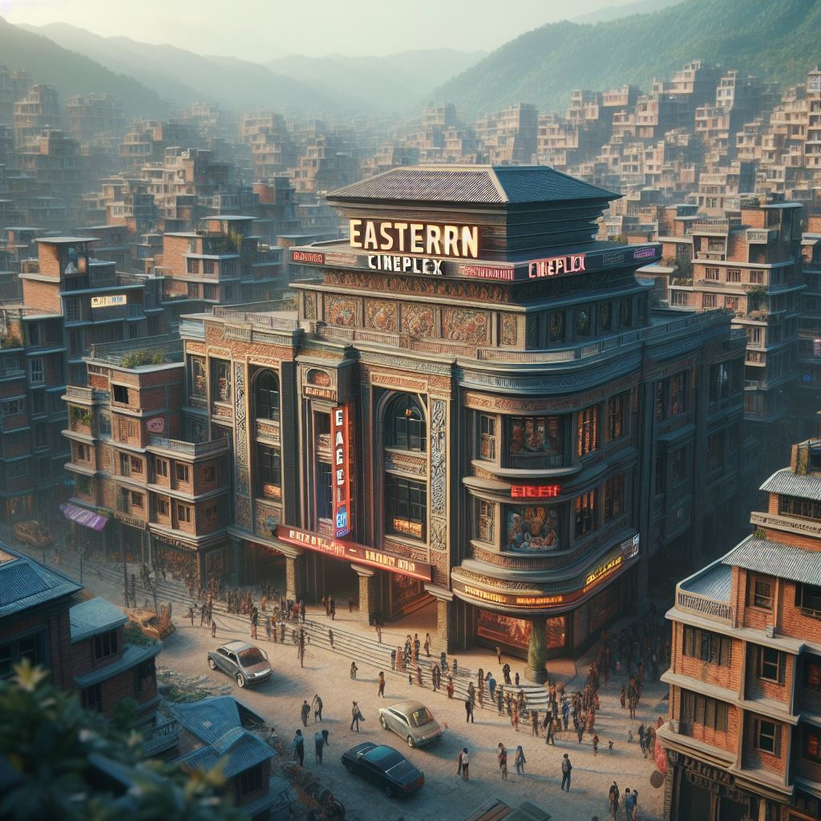
EASTERN CINEPLEX is a movie ticket booking project developed as a part of assessment for first semester electronics/computer engineering by ACES.
- AI generated image.
Our Features:
CUI based approach to a movie ticketing system.
Admin level control and user level access.
Organized program flow between systems.
Database like approach to data handling.
Multi-functional use of file handling and structures in C.

Slide 4
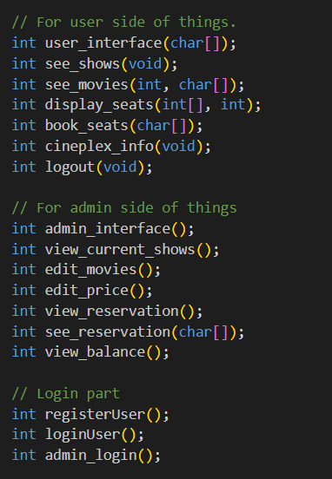
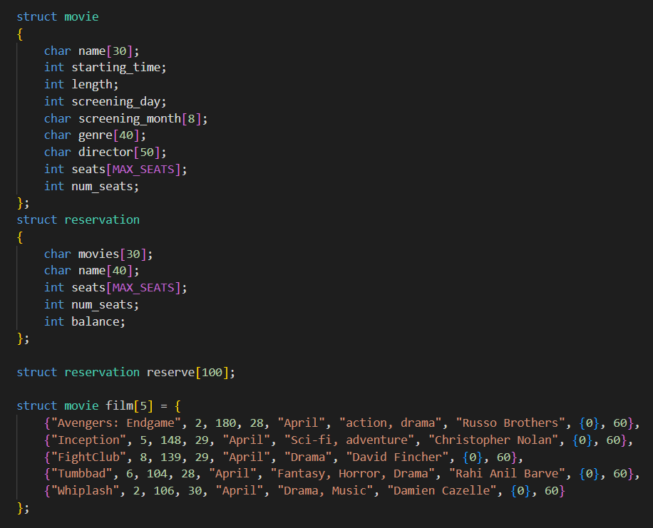
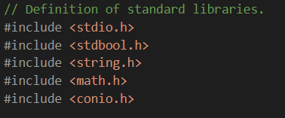
PROGRAM DESCRIPTION
Function Prototypes:
Structure in C:
Standard Libraries:

Slide 5
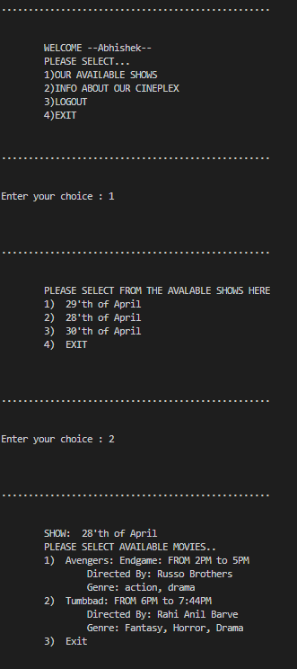
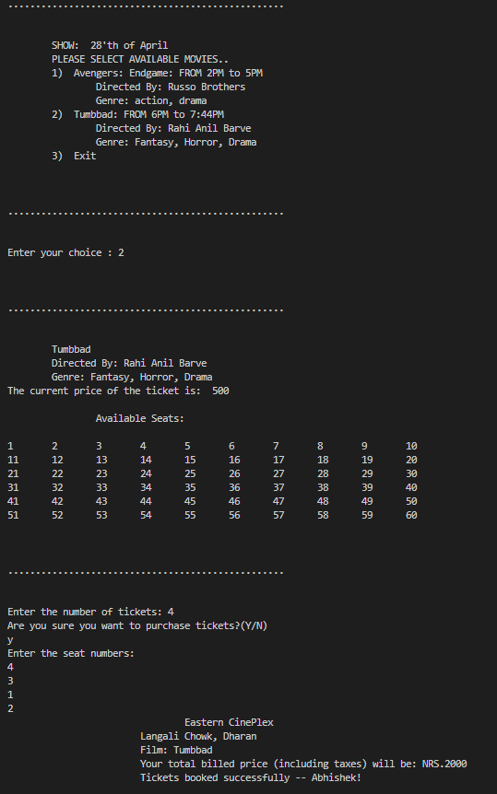
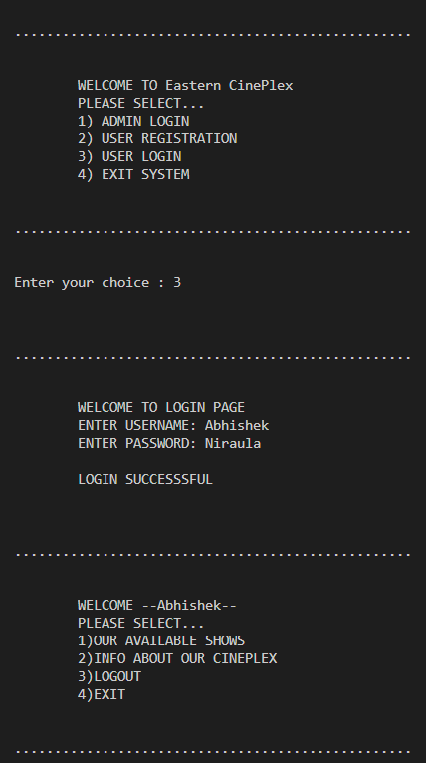
Program Output:
User Terminal:

Slide 6
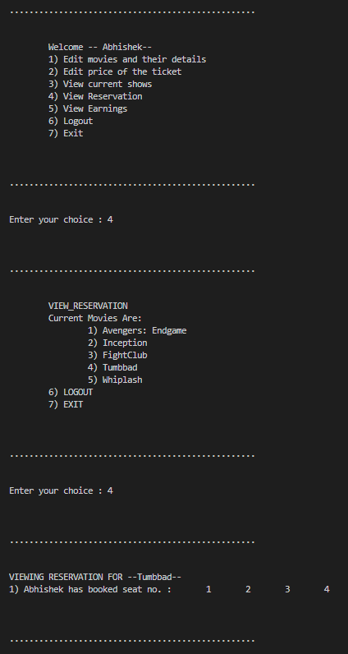
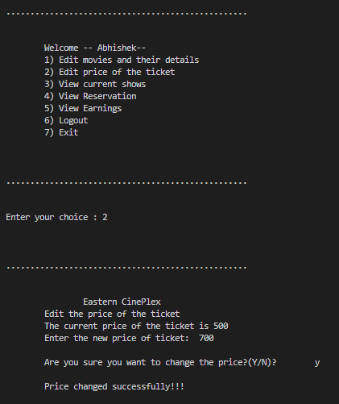
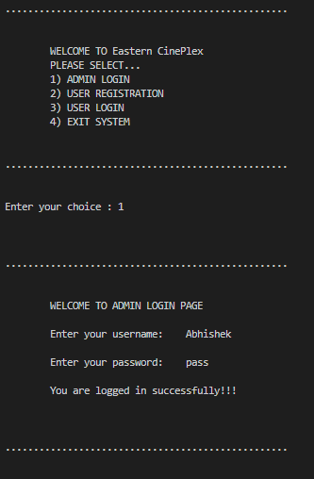
Program Output:
Admin Terminal :

Slide 7
CONCLUSION AND TAKEAWAYS:
The program at end runs in a infinite looping system and functions well until the user selects to end the program.
One major problem in the program is:
All of the changed and edited data is flushed after the user selects to end the program.
References :
Use of AI programs to understand project workflow and internal logics for some part.
www.geeksforgeeks.org
www.stackoverflow.com
www.github.com

